Slide 1
DS 4300
Amazon EC2 & Lambda
Mark Fontenot, PhD
Northeastern University
Based in part on material from Gareth Eagar’s Data Engineering with AWS, Packt Publishing

Slide 2
EC2

Slide 3
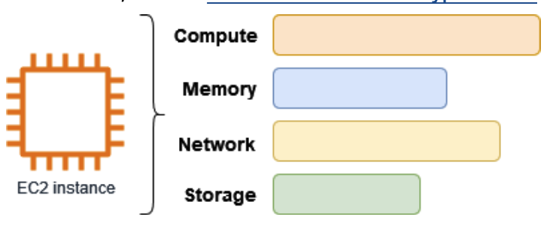
EC2
EC2 → Elastic Cloud Compute
Scalable Virtual Computing in the Cloud
Many (Many!!) instance types available
Pay-as-you-go model for pricing
Multiple different Operating Systems

Slide 4
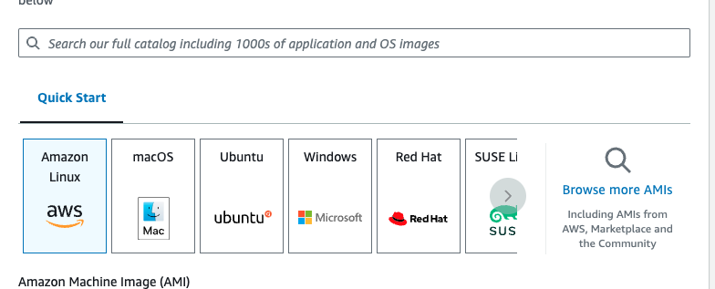
Features of EC2
Elasticity - easily (and programmatically) scale instances up or down as needed
You can use one of the standard AMIs OR provide your own AMI if pre-config is needed
Easily integrates with many other services such as S3, RDS, etc.
AMI = Amazon Machine Image

Slide 5
EC2 Lifecycle
Launch - when starting an instance for the first time with a chosen configuration
Start/Stop - Temporarily suspend usage without deleting the instance
Terminate - Permanently delete the instance
Reboot - Restart an instance without sling the data on the root volume

Slide 6
Where Can You Store Data?
Instance Store: Temporary, high-speed storage tied to the instance lifecycle
EFS (Elastic File System) Support - Shared file storage
EBS (Elastic Block Storage) - Persistent block-level storage
S3 - large data set storage or EC2 backups even

Slide 7
Common EC2 Use Cases
Web Hosting - Run a website/web server and associated apps
Data Processing - It’s a VM… you can do anything to data possible with a programming language.
Machine Learning - Train models using GPU instances
Disaster Recovery - Backup critical workloads or infrastructure in the cloud

Slide 8
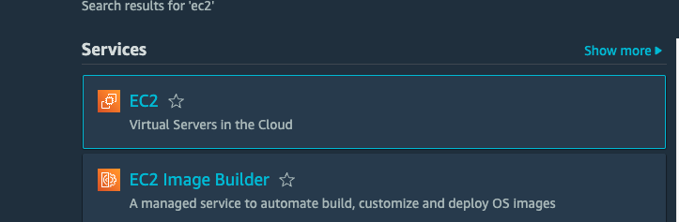
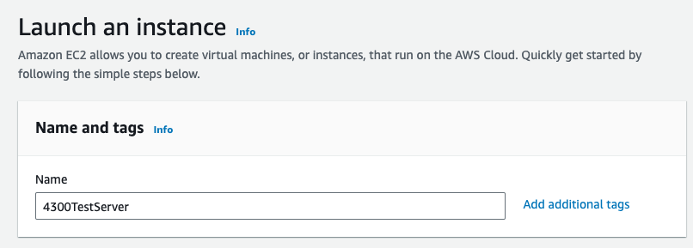
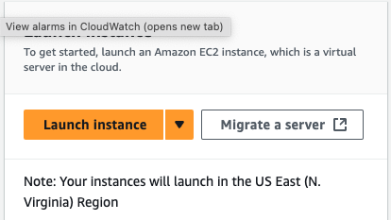
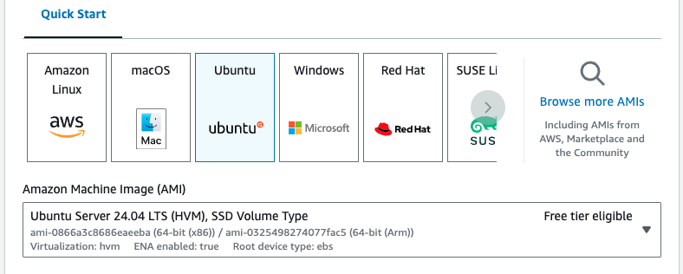
Let’s Spin Up an EC2 Instance

Slide 9
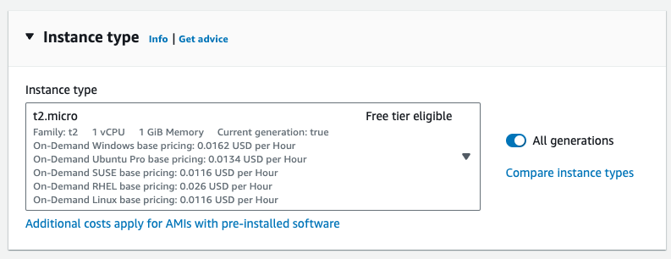
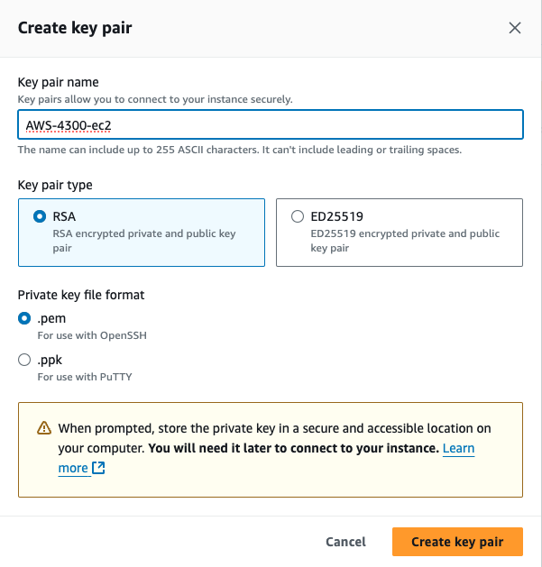
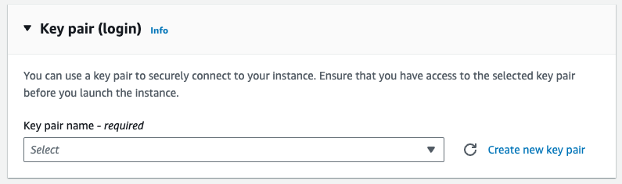
Let’s Spin Up an EC2 Instance

Slide 10
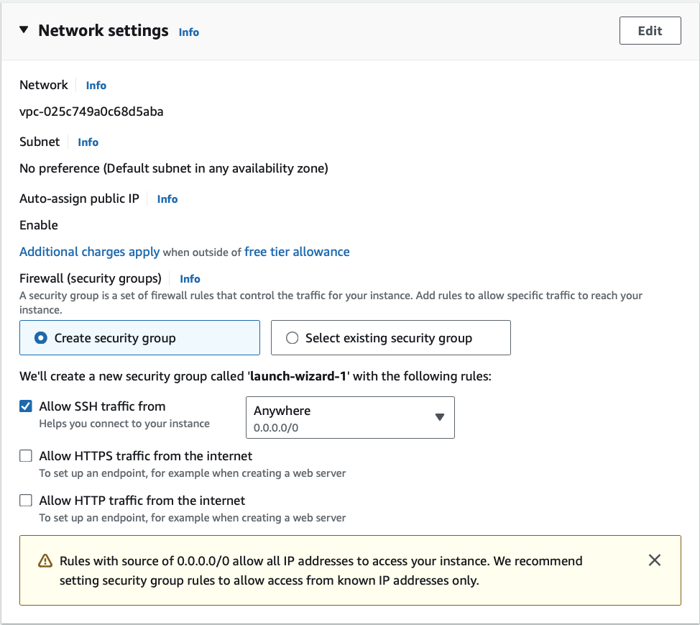
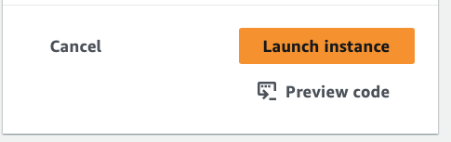
Let’s Spin Up an EC2 Instance

Slide 11
Ubuntu VM Commands
Initial user is ubuntu
Access super user commands with sudo
Package manager is apt
kind of like Homebrew or Choco
Update the packages installed
sudo apt update; sudo apt upgrade

Slide 12
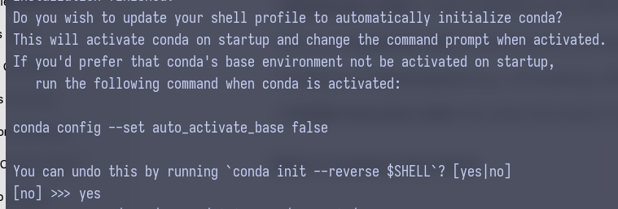
MiniConda on EC2
Make sure you’re logged in to your EC2 instance
Let’s install MiniConda
curl -O https://repo.anaconda.com/miniconda/Miniconda3-latest-Linux-x86_64.sh
bash ./Miniconda3-latest-Linux-x86_64.sh

Slide 13
Installing & Using Streamlit
Log out of your EC2 instance and log back in
Make sure pip is now available:
pip --version
Install Streamlit and sklearn
pip install streamlit scikit-learn
Make a directory for a small web app
mkdir web
cd web

Slide 14
Basic Streamlit App
import streamlit as st
def main():
st.title("Welcome to my Streamlit App")
st.write("## Data Sets")
st.write("""
- data set 01
- data set 02
- data set 03
""")
st.write("\n")
st.write("## Goodbye!")
if __name__ == "__main__":
main()
nano test.py
Add code on left
ctrl-x to save and exit
streamlit run test.py

Slide 15
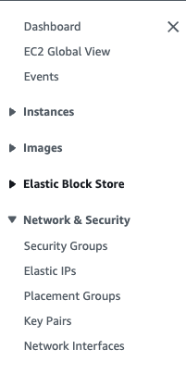
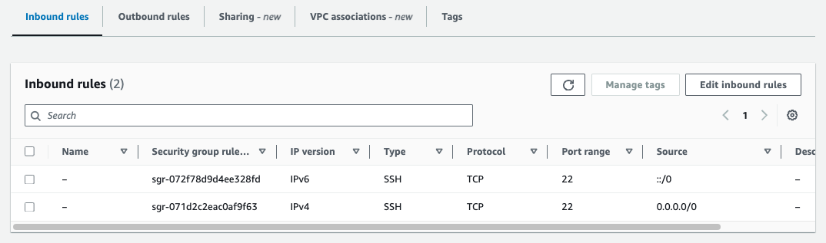
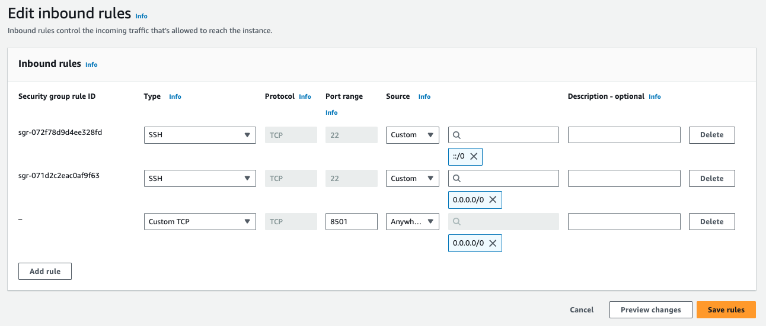
Opening Up The Streamlit Port

Slide 16
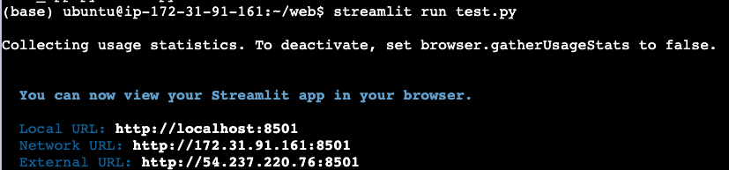
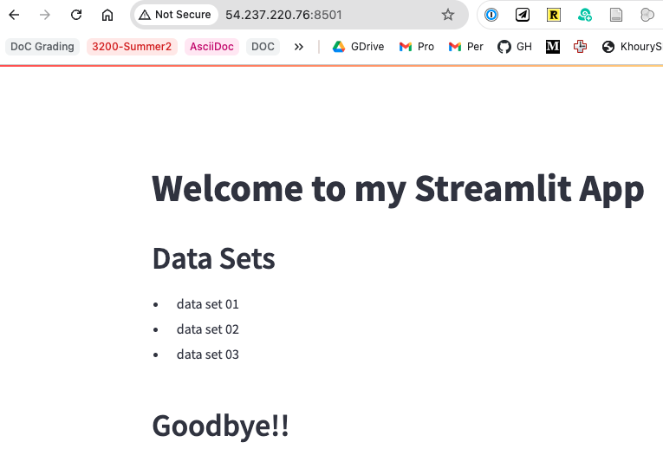
In a Browser

Slide 17
AWS Lambda

Slide 18
Lambdas
Lambdas provide serverless computing
Automatically run code in response to events.
Relieves you from having to manage servers - only worry about the code
You only pay for execution time, not for idle compute time (different from EC2)

Slide 19
Lambda Features
Event-driven execution - can be triggered by many different events in AWS
Supports a large number of runtimes… Python, Java, Node.js, etc
HIGHLY integrated with other AWS services
Extremely scalable and can rapidly adjust to demands

Slide 20
How it Works
Add/upload your code through AWS MGMT console
Configure event source(s)
Watch your Lambda run when one of the event sources fires an event

Slide 21
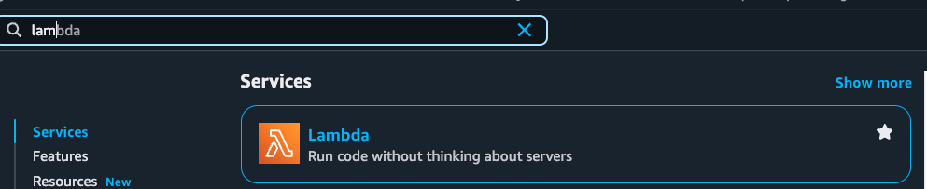
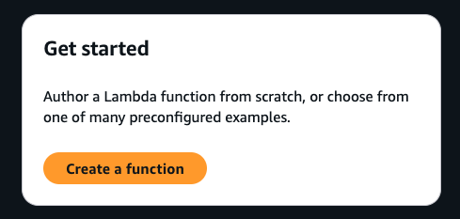
Let’s Make One

Slide 22
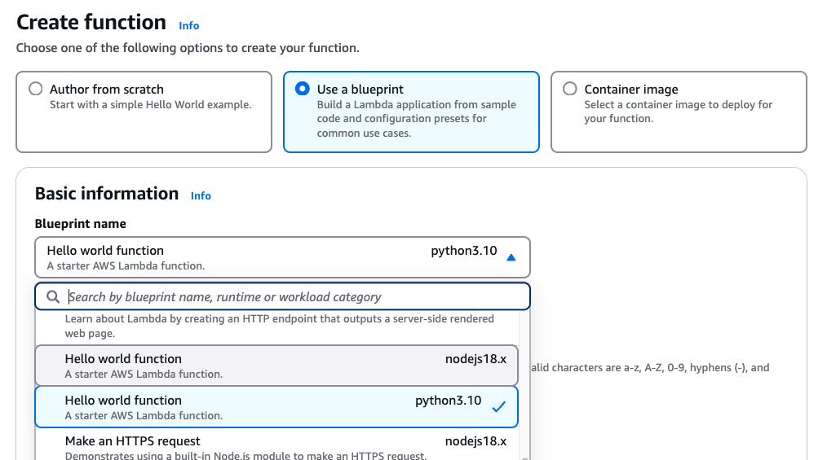
Making a Lambda

Slide 23
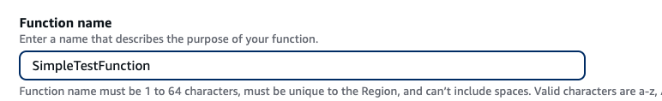
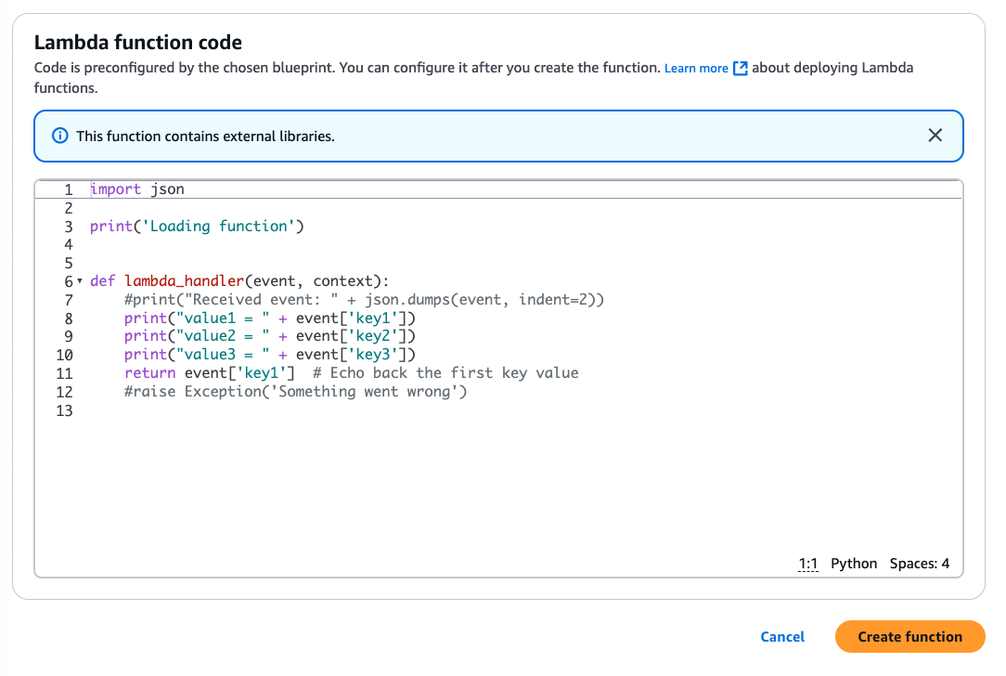
Creating a Function

Slide 24
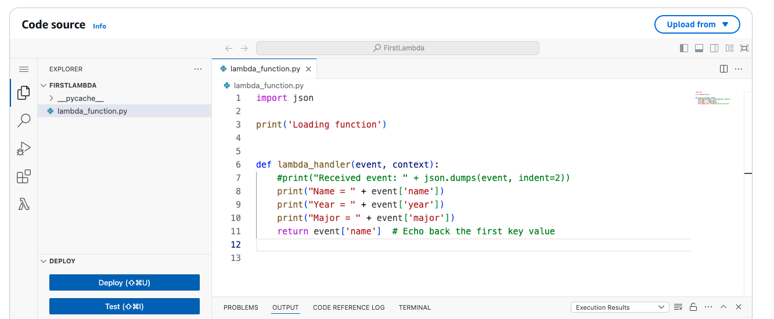
Sample Code
Edit the code
Deploy the code!

Slide 25
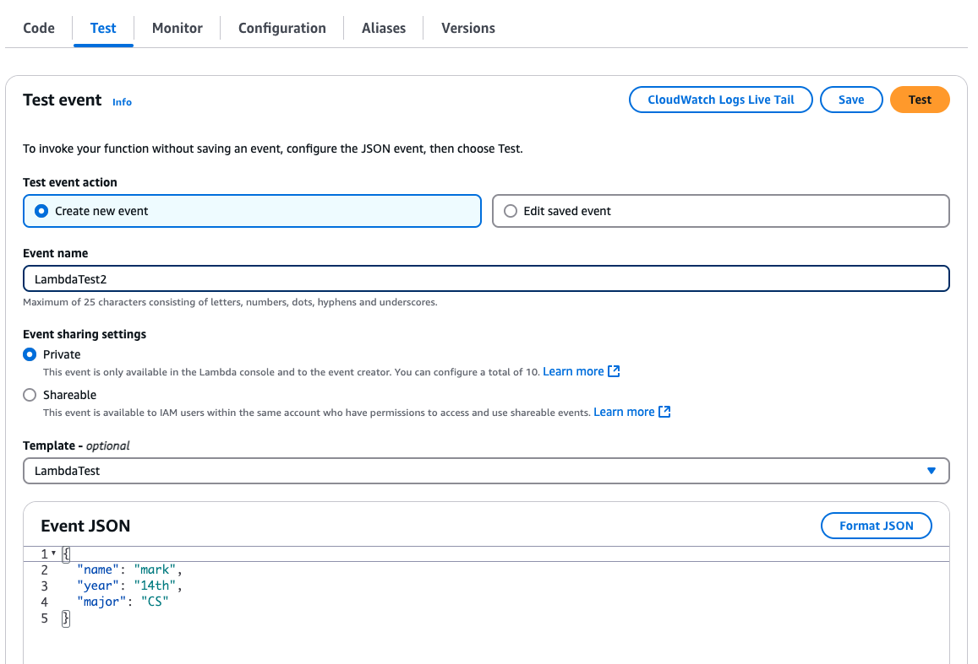
Test It

Slide 26
??

